Slide 1


Data Analysis
DVD Rental service

Slide 2
Stages
1. Ask The Right Questions.
2. Data Collection.
3. Data Cleaning.
4. Analyzing The Data.
5. Interpreting The Results.

Slide 3
What is our business challenge?
The owner of a DVD rental service came to us and brought information about his business. Based on it, he would like to gain insights regarding his business and actionable recommendations based on them.
He is interested in cool insights about the film-industry.
Notes:
Correct formulation of the problem.
The business objective should include 3 metrics:
volume
price
quality
If even one of the metrics is missed, performance measurement becomes problematic.

Slide 4
1. Ask The Right Questions
How are the rental period presented in our dataset?
At what rental price do customers choose DVD more often?
What categories of films does a business owner need to purchase?
How does the number of clients depend on the properties of the films presented?
If a business owner wants to open another store, where is it better to do it?
Which clients are the most active?

Slide 5
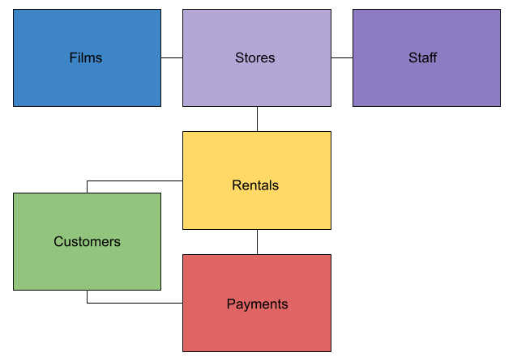
2. Data Collection

Slide 6
3. Data Cleaning
Import the Data
Investigate the Data
Check duplicate or irrelevant observations
Check structural errors
Filter unwanted outliers
Handle missing data
Format Data
Validate and QA

Slide 7
4. Analyzing The Data
Quantitative Data Analysis (overall trends)
Diagnostic analysis (a correlation matrix)
Time series analysis
Cohort analysis
Data Visualization
Data Interpretation

Slide 8

5. Interpreting The Results
Review the performed analysis
Interpretation of results
Conclusions, insights and recommendations

